Slide 1
Planning for Success

Slide 2
Introduction
The critical factors you must know for the planning and execution of a successful BI program.

Slide 3
Organizational Preparedness for Business Intelligence and Analytics

Slide 4
Organizational Preparedness for Business Intelligence and Analytics
What is meant by organizational preparedness?
At the highest level, it is a state within the organization in which both management and staff are prepared to:
  Execute performance improvement measurement
  Identify opportunities for benefits
  Make changes to processes
  Make changes to behavior as a result
  Monitor improvement in relation to process and behavior changes

Slide 5
1. ORGANIZATIONAL READINESS
assess alignment between the objectives at different levels of management
recognize that their behavior is motivated by alternate factors.

Slide 6
2. MANAGEMENT READINESS
consider is the support of a program champion who can influence both upper management to gain their buy-in as well as stoking interest among the stakeholders who would either help fund the program or benefit from it.

Slide 7
3. OPERATIONAL READINESS
implies that engagement has been institutionalized: budgets have been allocated, skilled staff members have been hired, the customers and stakeholders have been engaged and trained

Slide 8
4. PREPARING FOR CHANGE
Understanding the business problem by examining the core business challenges
Assessment and determining feasibility by considering the unknowns and seeing whether the methods of addressing the similar business problems can be adapted to this problem,
Planning to develop the analytical solution by performing a data requirements assessment, determining the tools and methodologies to be employed, conditions for success, and barriers to execution
Execution of the solution by engaging the team members, assigning their tasks, building the solution, and measuring improvement

Slide 9
Initial Steps in Starting a Business Intelligence Program

Slide 10
Fundamental aspects of the BI program such as:
  Championship. Senior-level champions ensuring corporate sponsorship;
  Level-Setting. Establishing high-level goals and setting expectations;
  Partnering. Creating a partnership among the participants that provides incentives to act strategically;
  Vision. Asserting a strategic vision that guides design, development, and deployment;
  Plan. Establishing a plan that delivers intermediate value while achieving the long-term goals.

Slide 11
1. CHAMPIONSHIP AND MANAGEMENTSPONSORSHIP
the failure of a BI program is the lack of senior-level sponsorship. But what is meant by senior-level sponsorship.
The first concept focuses on establishing a partnership with a senior-level manager
The second concept focuses on the senior management’s establishing a vested stake in the success of the project.

Slide 12
Bridging the Gaps between Information Technology and the Business Users

Slide 13
Introduction
The evolution of technical resources are the success factors in gaining the best advantage from a BI and analytics program is establishing a partnership between the business users and the information technology team
In the early days of computing, all technical/business analysts shared time on huge computers housed in separate rooms; the services provided were purely operational there were no BI applications at all.
But as technology increasingly has become both smaller and more affordable, there are corresponding changes in connecting technology to the business.

Slide 14
1. DICHOTOMY
There is a artificial boundary between those who require computer services and those who provide those services
there is a greater need for both technicians to solve problems with computer use and those who can translate a business user’s problems into a collection of technical issues.

Slide 15
2. PARTNERING
Fortunately, there is a growing knowledge overlap between the IT and business sides.
As the relationships between business units and IT groups grow, we find that the IT side gradually learns more and more about how the business works and that the business side has a growing understanding of the capabilities and limitations of the technology.

Slide 16
Knowing the Different Types of Business Intelligence Users

Slide 17
ANALYTIC DATABASES AND INFORMATION CONSUMERS
Power users
Business users
Casual users
Data aggregators or Information providers
Operational analytics users
Extended enterprise users
IT users

Slide 18
Business Intelligence Success Factors: A Deeper Dive

Slide 19
1. Strong, Dedicated Management
Direct the process of engaging the right business side participants;
Direct the solicitation of business user expectations and help translate those into specific requirements;
Guide the definition of success and the associated metrics;
Engage team members with the right skills and ensure proper training;
Manage the knowledge and technology acquisition process;
Develop and manage a program plan;
Manage program implementation; and
Defuse any political time bombs.

Slide 20
2. Setting Appropriate Expectations
Functionality
Accessibility
Performance
Delivery
Quality
Business relevance

Slide 21
3. Establishing Metrics for Success
Functionality
Accessibility
Performance
Delivery
Quality
Availability
Business relevance

Slide 22
Strategic Versus Tactical Planning

Slide 23
A tactical plan answers "how do we achieve our strategic plan?“
It outlines actions to achieve short-term goals, generally within a year or less.
They are much narrower in focus and can be broken down into the departmental or unit level.

Slide 24
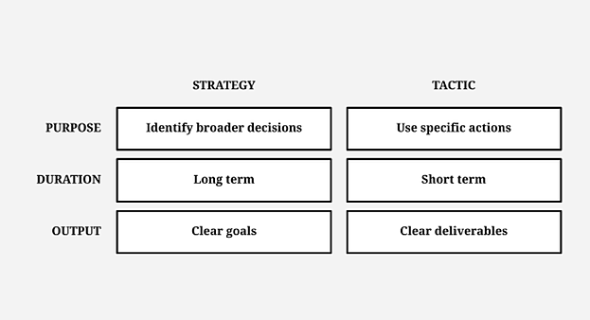
Strategic planning lays out the long-term, broad goals that a business or individual wants to achieve.
And tactical planning outlines the short-term steps and actions that should be taken to achieve the goals described in the strategic plan.

Slide 25
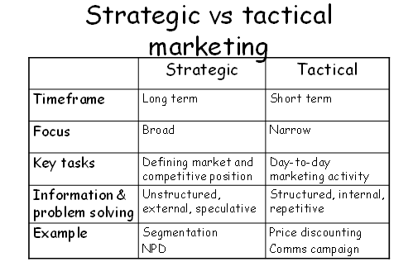

Slide 26
Introduction
If BI program failures are attributable to incomplete requirements and missed expectations, then to succeed, we must strike a balance between aiming to meet the long-term desires while satisfying the clients’ immediate needs in the short term.
Long-Term Goals
Short-Term Success

Slide 27
Developing Your Business Intelligence Roadmap
Business Intelligence Strategy: Vision to Blueprint
The Business Intelligence Roadmap: Example Phasing
Planning the Business Intelligence Plan

